Slide 1

Change the flow of a program
Behram Khan

Slide 2
Lecture Overview
In this first lecture we will cover the fundamental theoretical concepts that form the backbone of programming.
This session focuses solely on theory along with practical examples, providing a solid foundation for understanding computers and programming
Involving examples and interactive session to develop problem solving

Slide 3
Learning Objectives
By the end of this lecture, students will be able to:
Know syntax of different statements
Know how data is displayed on screen
Know how data is taken from user as input
Know how if statements work and nested if’s
Know what are Boolean operators

Slide 4
Getch
Reads single character input from user but doesn’t wait for us to press enter key, as soon as we press a key, it displays the output.
Doesn’t show the pressed key on screen, Hide inputs like password, ATM pins…
Notes:
STR: Store a value to memory.
ADD: Add two values.
SUB: Subtract one value from another.
MOV: Move data from one location to another.

Slide 5

Getch
#include <conio.h> // Library where getch() is stored
#include <stdio.h> int main() {
char ch;
printf("Press any key to continue...");
ch = getch(); // waits for a key press, doesn't display it
printf("\nYou pressed: %c\n", ch);
return 0;
}
Notes:
STR: Store a value to memory.
ADD: Add two values.
SUB: Subtract one value from another.
MOV: Move data from one location to another.

Slide 6
Flow of Control

Slide 7





Flow of Control
Statements in a program execute one after the other in the order in which you write them. This is called sequential execution.
Various C statements enable you to specify that the next statement to execute may be other than the next one in sequence. This is called transfer of control.
Notes:
STR: Store a value to memory.
ADD: Add two values.
SUB: Subtract one value from another.
MOV: Move data from one location to another.

Slide 8
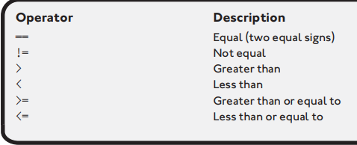
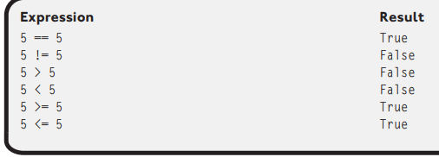
Comparison Operators
These are operators used to compare values and evaluate to either true or false.
Values being compared have to be of same datatype
Notes:
STR: Store a value to memory.
ADD: Add two values.
SUB: Subtract one value from another.
MOV: Move data from one location to another.

Slide 9
Flow of Control
An algorithm is a step-by-step process for solving a problem
To write an algorithm we use Pseudo Code and Flowchart
Notes:
STR: Store a value to memory.
ADD: Add two values.
SUB: Subtract one value from another.
MOV: Move data from one location to another.

Slide 10
Problem Statement 1
Turn the air conditioning on when the temperature is greater than or equal to 80 degrees or else turn it off.
Identify the Inputs, processing, outputs in the pseudocode.
Notes:
STR: Store a value to memory.
ADD: Add two values.
SUB: Subtract one value from another.
MOV: Move data from one location to another.

Slide 11
Problem Statement 1 PseudoCode
if temperature >= 80
Turn AC on
else
Turn AC off
end if
This is pseudocode not actual code, if u paste this in a C Program, it wont compile.
Notes:
STR: Store a value to memory.
ADD: Add two values.
SUB: Subtract one value from another.
MOV: Move data from one location to another.

Slide 12
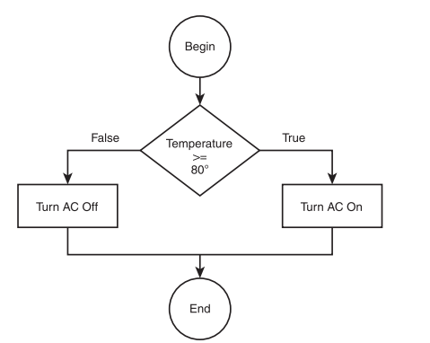
Problem Statement 1 Flowchart
Notes:
STR: Store a value to memory.
ADD: Add two values.
SUB: Subtract one value from another.
MOV: Move data from one location to another.

Slide 13
Problem Statement 2
Allow a customer to deposit or withdraw money from a bank account, and if a user elects to withdraw funds, ensure that sufficient money exist.
Identify the Inputs, processing, outputs in the pseudocode.
Notes:
STR: Store a value to memory.
ADD: Add two values.
SUB: Subtract one value from another.
MOV: Move data from one location to another.

Slide 14
Problem Statement 2 PseudoCode
if action == deposit
Deposit funds into account
else
if balance < withdraw amount
Insufficient funds for transaction
else
Withdraw monies
end if
end if
Notes:
STR: Store a value to memory.
ADD: Add two values.
SUB: Subtract one value from another.
MOV: Move data from one location to another.

Slide 15
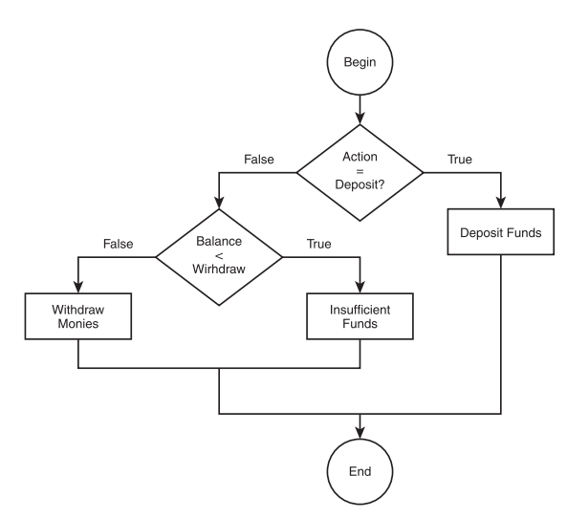
Problem Statement 2 Flowchart
Notes:
STR: Store a value to memory.
ADD: Add two values.
SUB: Subtract one value from another.
MOV: Move data from one location to another.

Slide 16
If statement A Decision-Making Tool

Slide 17
If Statement
An if statement allows you to execute a block of code only if a certain condition is true.
It's like a decision-making process: if a specific condition is met, you take one action; otherwise, you take another.
Syntax :
if (condition)
{ Code to be executed if the condition is true }
• Condition: This is an expression that evaluates to either true or false.
• Code Block: This is a block of code that will be executed if the condition is true.
Notes:
STR: Store a value to memory.
ADD: Add two values.
SUB: Subtract one value from another.
MOV: Move data from one location to another.

Slide 18
Temperature Checking
if (Temperature >= 80) {
//Turn AC on
printf("\nThe AC is on\n");
}
If(Temperature <= 20)
//Turn AC off
printf("\nThe AC is off\n");
}
AcOnOff.c
Notes:
STR: Store a value to memory.
ADD: Add two values.
SUB: Subtract one value from another.
MOV: Move data from one location to another.

Slide 19
Even Odd
if ( number % 2 == 0 ) {
printf("\n Number is even \n");
}
EvenOdd.c
Notes:
STR: Store a value to memory.
ADD: Add two values.
SUB: Subtract one value from another.
MOV: Move data from one location to another.

Slide 20
If else Statement
An if-else statement lets you execute one block of code if a specific condition is true, and a different block of code if that condition is false. It allows for two possible outcomes: one action when the condition is met and another when it isn’t.
if (condition) { // Code to be executed if the condition is true}
else { // Code to be executed if the condition is false}
Condition: This is an expression that evaluates to either true or false.
If Block: This block of code executes if the condition is true.
Else Block: This block of code executes if the condition is false.
Notes:
STR: Store a value to memory.
ADD: Add two values.
SUB: Subtract one value from another.
MOV: Move data from one location to another.

Slide 21
If else Statement
if (Temperature >= 80) {
//Turn AC on
printf("\nThe AC is on\n");
}
else {
//Turn AC off
printf("\nThe AC is off\n");
}
AcOnOff_If_Else.c
Notes:
STR: Store a value to memory.
ADD: Add two values.
SUB: Subtract one value from another.
MOV: Move data from one location to another.

Slide 22
If else Statement
START
SET number to 5
IF number is greater than 0 THEN
PRINT "The number is positive."
ELSE
PRINT "The number is not positive.“
End If
END
positiveNumber.c
Notes:
STR: Store a value to memory.
ADD: Add two values.
SUB: Subtract one value from another.
MOV: Move data from one location to another.

Slide 23
Nested If
A nested if statement is a decision-making structure that allows you to check multiple conditions within another if or else block.
In simple terms, it means having an if statement inside another if statement. This helps in making decisions based on more than one condition.
Notes:
STR: Store a value to memory.
ADD: Add two values.
SUB: Subtract one value from another.
MOV: Move data from one location to another.

Slide 24


Checking if a number is positive, and if positive, whether it’s even or odd.
START
SET number to 8
IF number is greater than 0 THEN
IF number MOD 2 is equal to 0 THEN
PRINT "The number is positive and even."
END IF
IF number MOD 2 is not equal to 0 THEN
PRINT "The number is positive and odd."
END IF
END IF
END
PositiveAndEvenOdd.c
Notes:
STR: Store a value to memory.
ADD: Add two values.
SUB: Subtract one value from another.
MOV: Move data from one location to another.

Slide 25
Else If
Else if is a conditional statement that allows you to specify multiple conditions to be evaluated in a sequence.
Adding condition to the else part of if else
If no conditions are met, an optional ELSE can be used to handle all remaining cases.
Syntax:
if (condition1) { // Code to be executed if condition1 is true}
else if (condition2) { // Code to be executed if condition1 is false and condition2 is true}
else if (condition3) { // Code to be executed if condition1 and condition2 are false and condition3 is true}
else { // Code to be executed if none of the above conditions are true}
Notes:
STR: Store a value to memory.
ADD: Add two values.
SUB: Subtract one value from another.
MOV: Move data from one location to another.

Slide 26
Else If
if ( number > 0 ) {
printf("\n Number is Positive \n");
}
Else
{
Printf(“Number is Negative”);
}
Notes:
STR: Store a value to memory.
ADD: Add two values.
SUB: Subtract one value from another.
MOV: Move data from one location to another.

Slide 27
Else If
#include <stdio.h>
int main() {
int number = 10;
if (number > 0)
{ printf("The number is positive.\n"); }
else if (number == 0)
{ printf("The number is zero.\n"); }
else
{ printf("The number is negative.\n"); }
return 0;
}
Notes:
STR: Store a value to memory.
ADD: Add two values.
SUB: Subtract one value from another.
MOV: Move data from one location to another.

Slide 28
Problem Statement
Create a program that simulates a traffic light system by displaying instructions based on the color of the traffic light. If the light is "green," the program should display "Go." If the light is "yellow," it should display "Slow down." If the light is "red," it should display "Stop." If the input does not match any of these colors, the program should display "Invalid light color.“
Identify Inputs, Outputs and Processing
Notes:
STR: Store a value to memory.
ADD: Add two values.
SUB: Subtract one value from another.
MOV: Move data from one location to another.

Slide 29
Problem Statement
Input the color of the traffic light (stored in lightColor).
IF lightColor is equal to "green"
THEN display "Go."
ELSE IF lightColor is equal to "yellow"
THEN display "Slow down."
ELSE IF lightColor is equal to "red"
THEN display "Stop."
ELSE
Display "Invalid light color."
End IF
Notes:
STR: Store a value to memory.
ADD: Add two values.
SUB: Subtract one value from another.
MOV: Move data from one location to another.

Slide 30
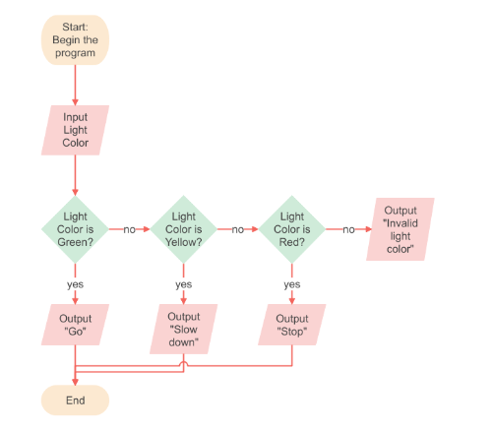
Flowchart
Notes:
STR: Store a value to memory.
ADD: Add two values.
SUB: Subtract one value from another.
MOV: Move data from one location to another.

Slide 31
Code
if (lightColor == "green")
{ printf("Go\n"); }
else if (lightColor == "yellow")
{ printf("Slow down\n"); }
else if (lightColor == "red")
{ printf("Stop\n"); }
else
{ printf("Invalid light color\n"); }
Notes:
STR: Store a value to memory.
ADD: Add two values.
SUB: Subtract one value from another.
MOV: Move data from one location to another.

Slide 32
Code
Last else of else if doesn’t have if statement. It gets executed only when all the previous statements have not run, meaning they were false.
Generally statements which have a body doesn’t need terminal ‘’ ; ’’ at end.
Notes:
STR: Store a value to memory.
ADD: Add two values.
SUB: Subtract one value from another.
MOV: Move data from one location to another.

Slide 33
Boolean Algebra

Slide 34
Boolean Algebra
Boolean algebra is named after George Boole, a mathematician in the nineteenth century. Boole developed his own branch of logic containing the values true and false and the operators and, or, and not to manipulate the values.
Boolean operators are used to combine or negate conditions in programming.
Three main Boolean operators are:
AND
OR
NOT
Notes:
STR: Store a value to memory.
ADD: Add two values.
SUB: Subtract one value from another.
MOV: Move data from one location to another.

Slide 35
The AND Operator
The AND operator builds a compound conditions.
Both conditions on either side must be true for the entire condition to be true
Example 1:
3 == 3 AND 4 == 4
Result: True (Both conditions are true)
Example 2:
3 == 4 AND 4 == 4
Result: False (Only one condition is true)
Notes:
STR: Store a value to memory.
ADD: Add two values.
SUB: Subtract one value from another.
MOV: Move data from one location to another.

Slide 36
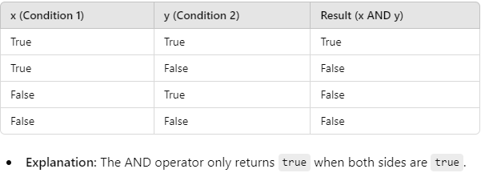
The AND Operator
Notes:
STR: Store a value to memory.
ADD: Add two values.
SUB: Subtract one value from another.
MOV: Move data from one location to another.

Slide 37
The OR Operator
The OR operator builds a compound conditions.
Only one condition needs to be true for the entire expression to be true.
Example 1:
4 == 3 AND 4 == 4
Result: True (One conditions is true)
Example 2:
3 == 4 AND 4 == 5
Result: False (Both conditions is false)
Notes:
STR: Store a value to memory.
ADD: Add two values.
SUB: Subtract one value from another.
MOV: Move data from one location to another.

Slide 38
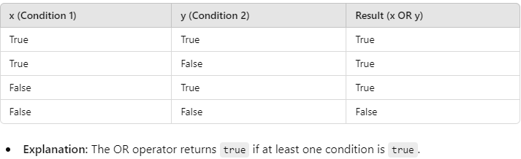
The OR Operator
Notes:
STR: Store a value to memory.
ADD: Add two values.
SUB: Subtract one value from another.
MOV: Move data from one location to another.

Slide 39
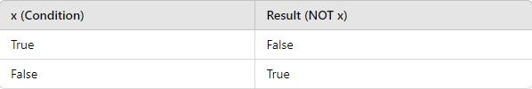
The NOT Operator
The NOT operator negates a condition.
It inverts the value of a condition (if it’s true, it becomes false; if it’s false, it becomes true).
Example 1:
NOT( 4 == 4 )
Result: False (4 == 4 is true, but NOT negates it)
Notes:
STR: Store a value to memory.
ADD: Add two values.
SUB: Subtract one value from another.
MOV: Move data from one location to another.

Slide 40
The NOT Operator
Notes:
STR: Store a value to memory.
ADD: Add two values.
SUB: Subtract one value from another.
MOV: Move data from one location to another.

Slide 41
Combining Operators
AND, OR, and NOT operators can be combined to create more complex conditions.
The order of operations is from Left to right :
NOT
AND
OR
Use parentheses () to control the order in which conditions are evaluated.
Notes:
STR: Store a value to memory.
ADD: Add two values.
SUB: Subtract one value from another.
MOV: Move data from one location to another.

Slide 42
Combining Operators
Example:
NOT(4 == 4) AND (5 == 5 OR 3 == 3)
First, evaluate the conditions inside the parentheses.
Then, apply the NOT operator.
Finally, apply the AND operator.
Notes:
STR: Store a value to memory.
ADD: Add two values.
SUB: Subtract one value from another.
MOV: Move data from one location to another.

Slide 43
Combining Operators
Try to solve the following Boolean algebra problems, given
x = 5, y = 3, and z = 4
1. x > 3 and z == 4 → True
2. y >= 3 or z > 4 → True
3. NOT(x == 4 or y < z) → false
4. (z == 5 or x > 3) and (y == z or x < 10) → true
Notes:
STR: Store a value to memory.
ADD: Add two values.
SUB: Subtract one value from another.
MOV: Move data from one location to another.

Slide 44
Boolean in C Programming

Slide 45
AND Operator (&&)
The AND (&&) operator checks if both conditions on either side are true.
Syntax: condition1 && condition2
Result: The entire expression is true only if both conditions are true.
Example 1:
if ( 3 > 1 && 5 < 10 )
Result: True because both 3 > 1 and 5 < 10 are true.
Example 2:
if ( 3 > 5 && 5 < 5 )
Result: False because 3 > 5 is false, so the entire condition fails.
Notes:
STR: Store a value to memory.
ADD: Add two values.
SUB: Subtract one value from another.
MOV: Move data from one location to another.

Slide 46
OR Operator (||)
The OR (||) operator checks if at least one condition is true.
Syntax: condition1 || condition2
Result: The entire expression is true if either condition is true.
Example 1:
if ( 3 > 5 || 5 <= 5 )
Result: True because 5 <= 5 is true (even though 3 > 5 is false).
Example 2:
if ( 3 > 5 || 6 < 5 )
Result: False because both conditions 3 > 5 and 6 < 5 are false.
Notes:
STR: Store a value to memory.
ADD: Add two values.
SUB: Subtract one value from another.
MOV: Move data from one location to another.

Slide 47
NOT Operator (!)
The NOT (!) operator is used to invert a condition. It returns true if the condition is false, and false if the condition is true.
Syntax: !condition
Result: Reverses the truth value of the condition.
Example 1:
if ( !( 3 > 5 ) )
Result: True because 3 > 5 is false, and the NOT operator inverts it to true.
Example 2:
if ( !( 5 < 5 ) )
Result: True because 5 < 5 is false, and the NOT operator inverts it to true.
Notes:
STR: Store a value to memory.
ADD: Add two values.
SUB: Subtract one value from another.
MOV: Move data from one location to another.

Slide 48
Combining AND (&&), OR (||), and NOT (!) Operators
if ( !( 3 > 5 && 4 == 4 ) || 7 == 7 )
printf("Condition is true\n");
First, the && operator evaluates the left condition.
Then, the NOT operator negates the result.
Finally, the || operator checks if the final result is true or false.
Notes:
STR: Store a value to memory.
ADD: Add two values.
SUB: Subtract one value from another.
MOV: Move data from one location to another.

Slide 49
Combining AND (&&), OR (||), and NOT (!) Operators
#include <stdio.h>
int main() {
int a = 1;
int b = 0;
if ( a && b ) {
printf("&& checks if both a and b are true so its not \n" );
}
if ( a || b ) {
printf(" || checks if at least one of a or b is true so its true \n" );
}
if ( !(a && b) ) {
printf("a && b is false, so !(a && b) becomes true.\n" );
} }
Notes:
STR: Store a value to memory.
ADD: Add two values.
SUB: Subtract one value from another.
MOV: Move data from one location to another.

Slide 50
Input Validation
Checking for a range of values is a common programming practice for input validation. You
can use compound conditions and relational operators to check for value ranges, as shown
in the following program:
InputValidation.c
VotingBoolean.c
Notes:
STR: Store a value to memory.
ADD: Add two values.
SUB: Subtract one value from another.
MOV: Move data from one location to another.

